Slide 1
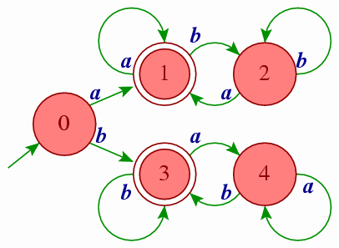
Unit-2
Regular Languages & Finite Automata

Slide 2
Topics to be covered
Language
Regular expressions & Regular languages
Finite Automata
Union, Intersection and Complement of Regular Languages
Non-Deterministic Finite Automata
Conversion from NFA to FA
^ - Non-Deterministic Finite Automata
Conversion of NFA-^ to FA
Kleene’s Theorem Part – I
Finite Automata with Output (Moore machine, Mealy machine)
Minimization of FA
Moore machine & Mealy machine
Pumping Lemma – Regular and Non Regular Languages

Slide 3
Languages

Slide 4
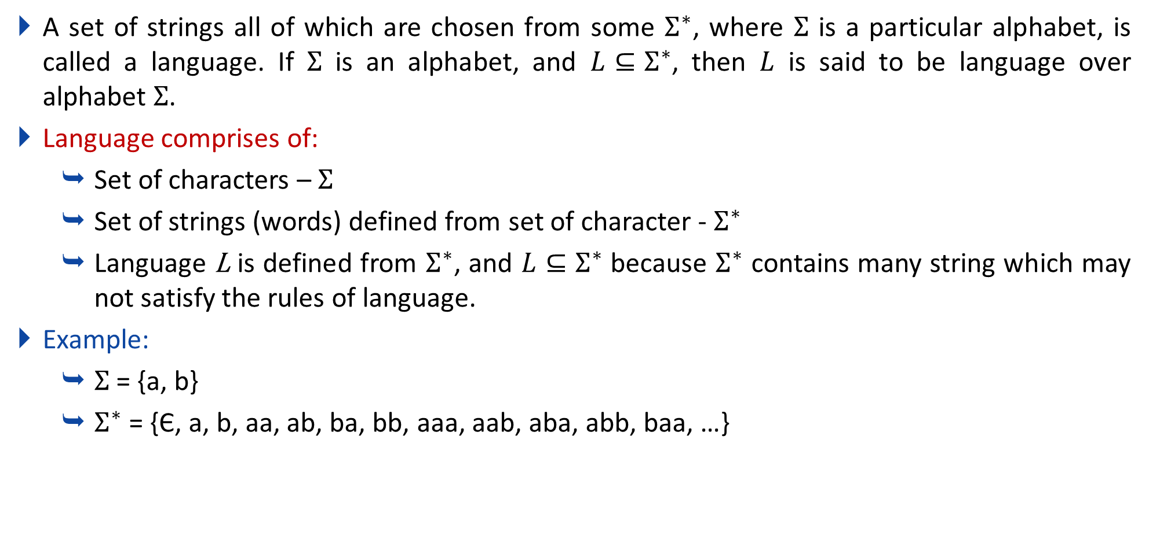
Language
A set of strings all of which are chosen from some $Σ^{∗}$, where $Σ$ is a particular alphabet, is called a language. If $Σ$ is an alphabet, and $L⊆Σ^{∗}$, then $L$ is said to be language over alphabet $Σ$.
Language comprises of:
Set of characters – $Σ$
Set of strings (words) defined from set of character - $Σ^{∗}$
Language L is defined from $Σ^{∗}$, and $L⊆Σ^{∗}$ because $Σ^{∗}$ contains many string which may not satisfy the rules of language.
Example:
$Σ$ = {a, b}
$Σ^{∗}$ = {Є, a, b, aa, ab, ba, bb, aaa, aab, aba, abb, baa, …}

Slide 5
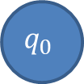

Difference between epsilon and phi
Epsilon(Є) is a 0 length string, whereas phi(ɸ) is a null, i.e. no string.
0,1
$$q_{0}$$
$$q_{0}$$
Epsilon(Є)
phi(ɸ)

Slide 6
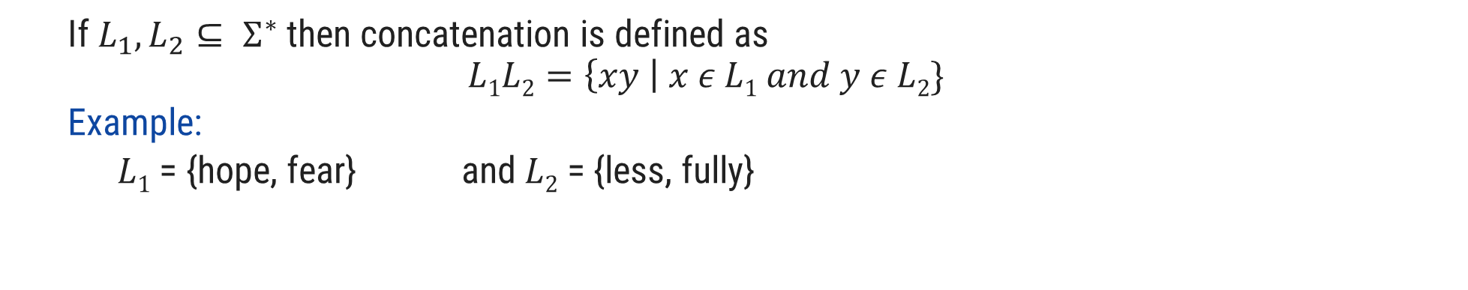
Operations over Language
Operations over the language are:
Concatenation
Union
* (Kleene closure)
+ (Positive closure)
If $L_{1}, L_{2}⊆ Σ^{∗}$ then concatenation is defined as
$$L1L2=\left\{xy \right| x ε L1 and y ε L2\}$$
Example:
$L1$ = {hope, fear} and $L2$ = {less, fully}
hopeless
$L1L2$ = {hopeless, hopefully, fearless, fearfully}

Slide 7

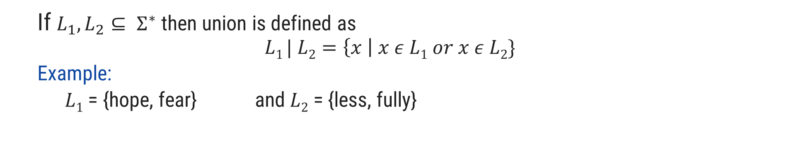
Operations over Language
Operations over the language are:
Concatenation
Union
* (Kleene closure)
+ (Positive closure)
If $L_{1}, L_{2}⊆ Σ^{∗}$ then union is defined as
$$L1 | L2=\left\{x \right| x ε L1 or x ε L2\}$$
Example:
$L1$ = {hope, fear} and $L2$ = {less, fully}
$L1 | L2$ = {hope, fear, less, fully}

Slide 8

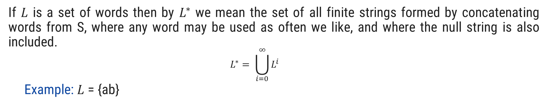
Operations over Language
Operations over the language are:
Concatenation
Union
* (Kleene closure)
+ (Positive closure)
If $L$ is a set of words then by $L^{∗}$ we mean the set of all finite strings formed by concatenating words from S, where any word may be used as often we like, and where the null string is also included.
$$L^{∗}= \bigcup_{i=0}^{∞}{L^{i}}$$
Example: $L$ = {ab}
$L$* = {^, ab, abab, ababab, abababab, ….}

Slide 9


Operations over Language
Operations over the language are:
Concatenation
Union
* (Kleene closure)
+ (Positive closure)
If $L$ is a set of words then by $L^{+}$ we mean the set of all finite strings formed by concatenating words from L, where any word may be used as often we like, and where the null string is not included.
$$L^{+}= \bigcup_{i=1}^{∞}{L^{i}}$$
Example:$L$ = {ab}
$L^{+}$ = {ab, abab, ababab, abababab, ….}

Slide 10
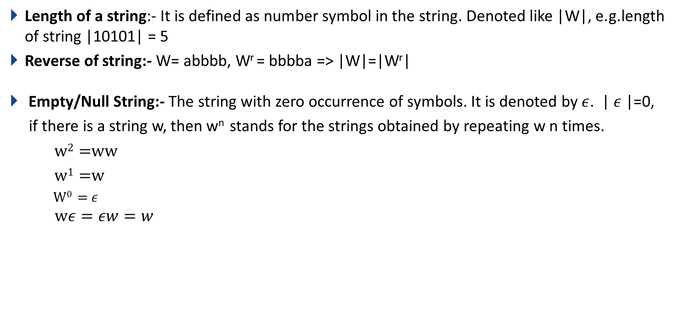
Some Basic operations on string
Length of a string:- It is defined as number symbol in the string. Denoted like |W|, e.g.length of string |10101| = 5
Reverse of string:- W= abbbb, W^{r} = bbbba => |W|=|W^{r}|
Empty/Null String:- The string with zero occurrence of symbols. It is denoted by $ε$. | $ε$|=0,
if there is a string w, then w^{n} stands for the strings obtained by repeating w n times.
w² =ww
w¹ =w
W⁰ = $ε$
$$wε=εw=w$$

Slide 11
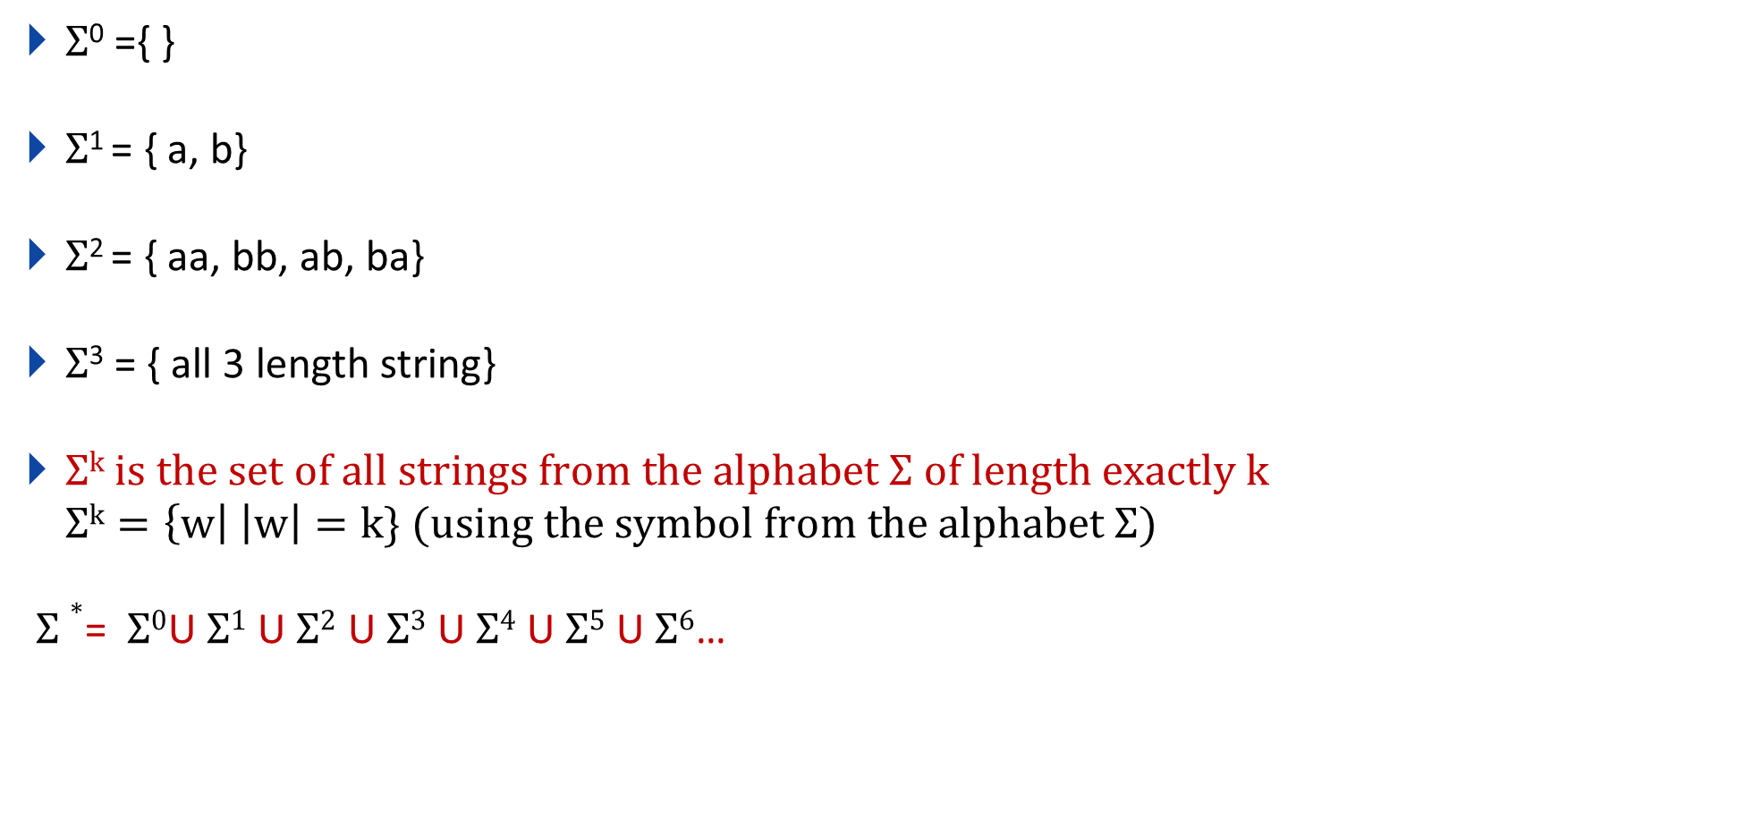
Q. If $Σ$={a,b} then, find the following?
$Σ$⁰ ={ }
$Σ$¹ = { a, b}
$Σ$² = { aa, bb, ab, ba}
$Σ$³ = { all 3 length string}
$Σk is the set of all strings from the alphabet Σ of length exactly k$
$$Σk=\left\{w\right| \left|w\right|=k\} (using the symbol from the alphabet Σ)$$
$Σ∗$= $Σ0$U$Σ1$ U$Σ2$ U$Σ3$ U$Σ4$ U$Σ5$ U$Σ6$…

Slide 12
Regular Expression

Slide 13
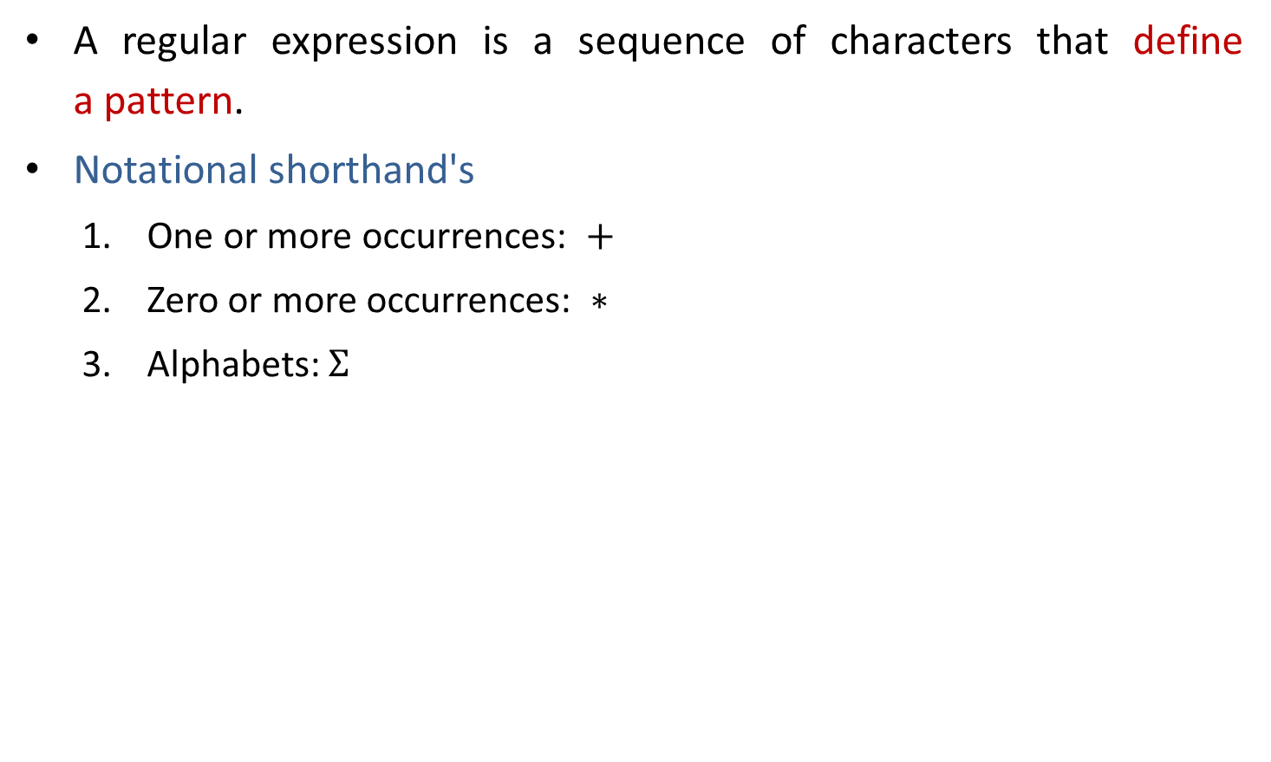
Regular expression
A regular expression is a sequence of characters that define a pattern.
Notational shorthand's
One or more occurrences: $+$
Zero or more occurrences: $∗$
Alphabets: $Σ$

Slide 14
Regular expression
a*
L = Zero or More Occurrences of a =
*
𝜖
a
aa
aaa
Infinite …..
aaaa
aaaaa…..

Slide 15
Regular expression
a⁺
L = One or More Occurrences of a =
+
a
aa
aaa
Infinite …..
aaaa
aaaaa…..

Slide 16
Precedence and associativity of operators
Operator | Precedence | Associative
Kleene * | 1 | left
Concatenation | 2 | left
Union | or + | 3 | left

Slide 17
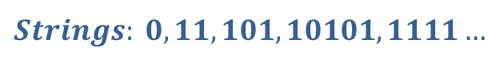
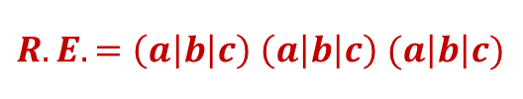



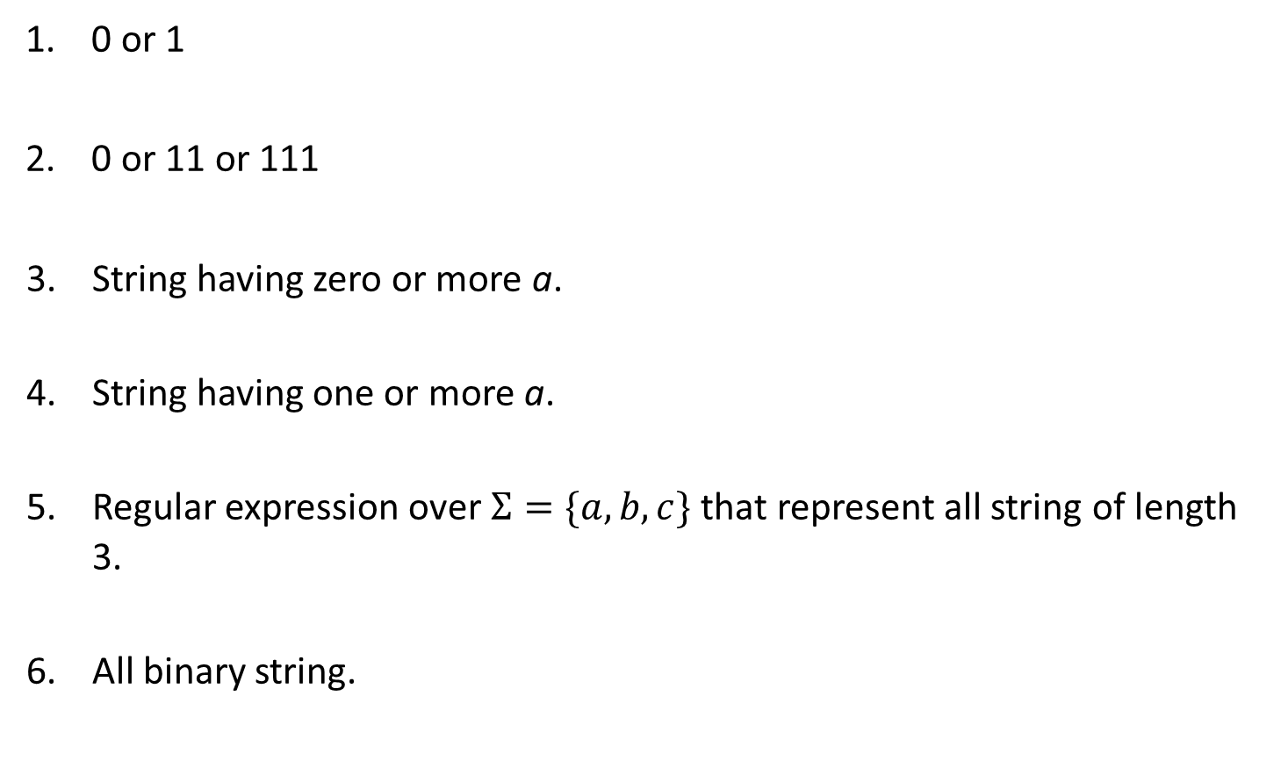



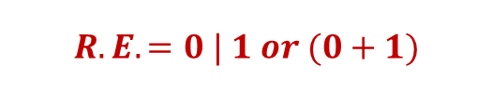

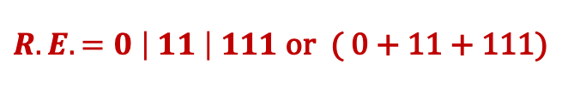

Regular expression examples
0 or 1
0 or 11 or 111
String having zero or more a.
String having one or more a.
Regular expression over $Σ=\{a,b,c\}$ that represent all string of length 3.
All binary string.
$$Strings: 0, 1$$
$$R.E. =0 | 1 or (0+1)$$
$$Strings: 0, 11, 111$$
$R.E. =0 \left| 11 \right| 111$ or ( 0 + 11 + 111)
$$Strings: ε,a, aa, aaa, aaaa…..$$
$$R.E. =a∗$$
$$Strings:a, aa, aaa, aaaa…..$$
$$R.E. =a+$$
$$Strings:abc, bca, bbb, cab, aba….$$
$$R.E. =\left(a\left|b\right|c\right) \left(a\left|b\right|c\right) (a\left|b\right|c)$$
$$Strings: 0, 11, 101, 10101, 1111…$$
$$R.E. =(0 | 1)+$$

Slide 18

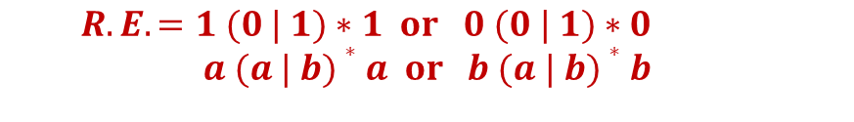
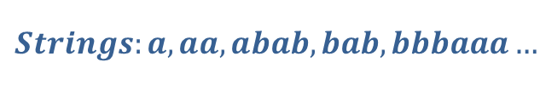






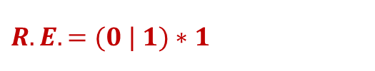

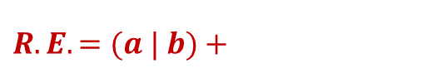
Regular expression examples
0 or more occurrence of either a or b or both
1 or more occurrence of either a or b or both
Binary no. ends with 0
Binary no. ends with 1
Binary no. starts and ends with 1
String starts and ends with same character
$$Strings:ε,a, aa, abab, bab…$$
$$R.E. =(a | b)∗$$
$$Strings:a, aa, abab, bab, bbbaaa…$$
$$R.E. =(a | b)+$$
$$Strings: 0, 10, 100, 1010, 11110…$$
$R.E. =(0 | 1)∗$ $0$
$$Strings:1, 101, 1001, 10101, …$$
$$R.E. =(0 | 1)∗1$$
$$Strings: 11, 101, 1001, 10101, …$$
$R.E. =1 (0 | 1)∗$ $1| 1$
$$Strings:00, 101, aba, baab…$$
$$R.E. =1 (0 | 1)∗1 or 0 (0 | 1)∗0$$
$$a (a | b)∗a or b (a | b)∗b$$

Slide 19




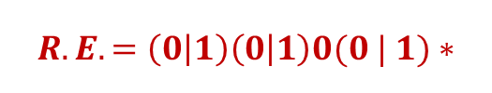
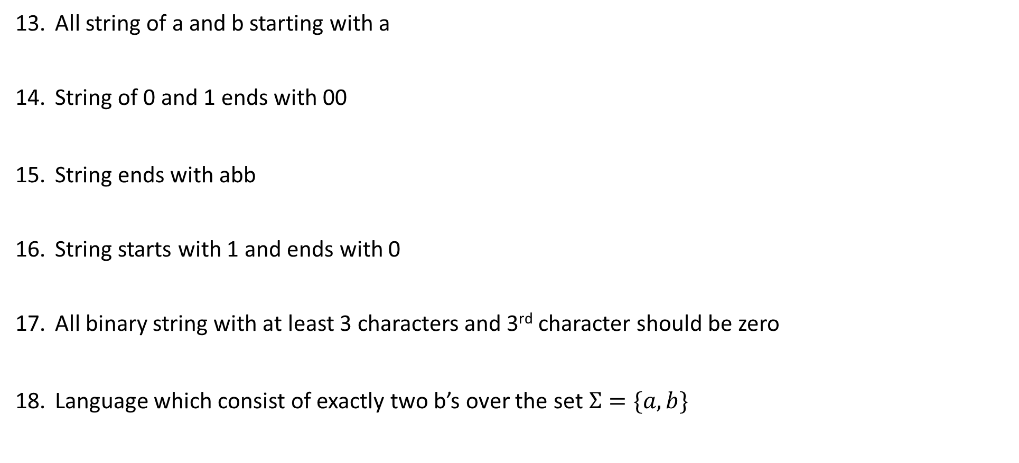





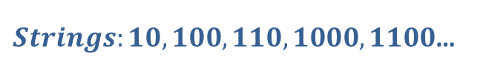

Regular expression examples
All string of a and b starting with a
String of 0 and 1 ends with 00
String ends with abb
String starts with 1 and ends with 0
All binary string with at least 3 characters and 3rd character should be zero
Language which consist of exactly two b’s over the set $Σ=\{a,b\}$
$Strings:a,ab,aab,abb$…
$$R.E. =a(a | b)∗$$
$Strings:00,100,000,1000,1100$…
$$R.E. =(0 | 1)∗00$$
$Strings:abb,babb, ababb$…
$$R.E. =(a | b)∗abb$$
$Strings:10,100,110,1000,1100$…
$$R.E. =1(0 | 1)∗0$$
$Strings:000,100,1100,1001$…
$$R.E. =\left(0 | 1\right)\left(0 | 1\right)0(0 | 1)∗$$
$Strings:bb,bab,aabb,abba$…
$$R.E. =a∗b a∗b a∗$$

Slide 20
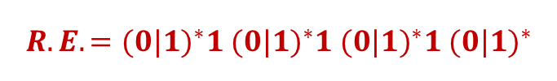
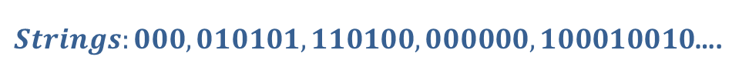


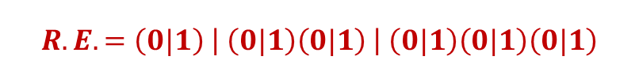
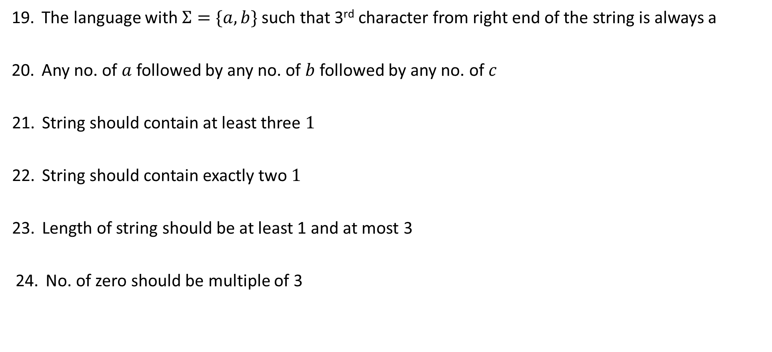




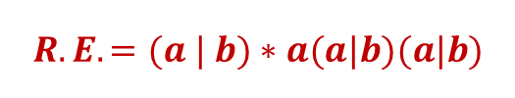


Regular expression examples
The language with $Σ=\{a,b\}$ such that 3rd character from right end of the string is always a
Any no. of $a$ followed by any no. of $b$ followed by any no. of $c$
String should contain at least three $1$
String should contain exactly two $1$
Length of string should be at least 1 and at most 3
No. of zero should be multiple of 3
$Strings:aaa,aba,aaba,abb$…
$$R.E. =(a | b)∗a(a|b)(a|b)$$
$Strings:ε,abc,aabbcc,aabc,abb$…
$$R.E. =a∗b∗c∗$$
$Strings:111,01101,0101110$….
$$R.E. ={(0|1)}^{∗}1{ (0|1)}^{∗}1{ (0|1)}^{∗}1 {(0|1)}^{∗}$$
$Strings:11,0101,1100,010010,100100$….
$$R.E. =0^{∗}10^{∗}10^{∗}$$
$Strings:0,1,11,01,111,010,100$….
$$R.E. =\left(0|1\right) \left| \left(0|1\right)\left(0|1\right) \right| \left(0|1\right)\left(0|1\right)\left(0|1\right)$$
$Strings:000,010101,110100,000000,100010010$….
$$R.E. ={(1^{∗}01^{∗}01^{∗}01^{∗})}^{∗}$$

Slide 21





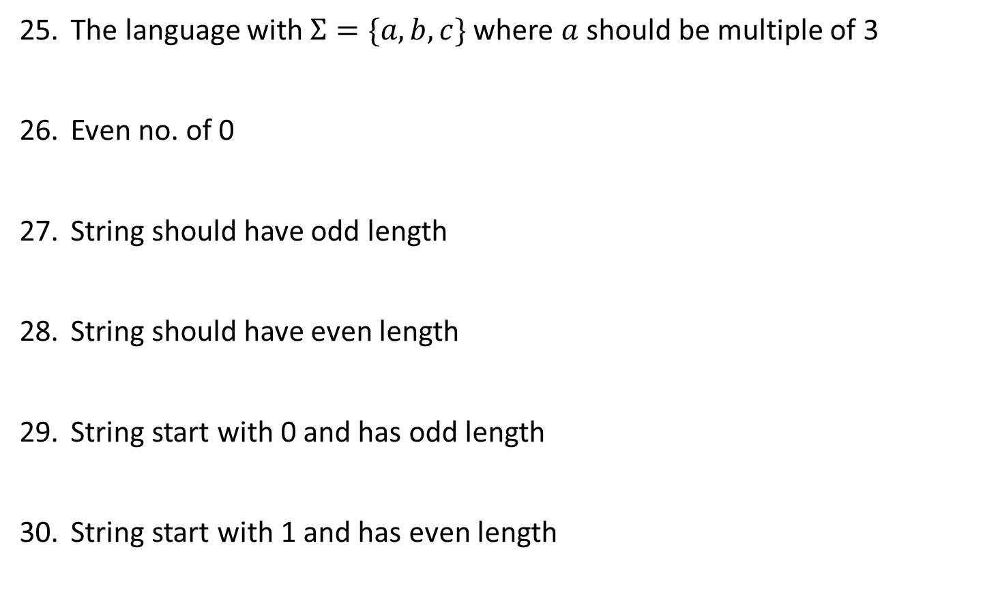




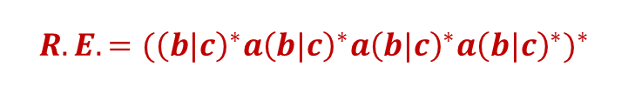


Regular expression examples
The language with $Σ=\{a,b,c\}$ where $a$ should be multiple of 3
Even no. of 0
String should have odd length
String should have even length
String start with 0 and has odd length
String start with 1 and has even length
$$Strings:aaa, baaa,bacaba,aaaaaa..$$
$$R.E. ={({\left(b|c\right)}^{∗}a{\left(b|c\right)}^{∗}a{\left(b|c\right)}^{∗}a{\left(b|c\right)}^{∗})}^{∗}$$
$Strings:00,0101,0000,100100$….
$$R.E. ={(1^{∗}01^{∗}01^{∗})}^{∗}$$
$Strings:0,010,110,000,10010$….
$$R.E. ={\left(0|1\right) (\left(0 | 1\right)(0|1))}^{∗}$$
$Strings:00,0101,0000,100100$….
$$R.E. ={ (\left(0 | 1\right)(0|1))}^{∗}$$
$Strings:0,010,010,000,00010$….
$$R.E. ={\left(0\right) (\left(0 | 1\right)(0|1))}^{∗}$$
$Strings:10,1100,1000,100100$….
$$R.E. ={ 1(0|1)(\left(0 | 1\right)(0|1))}^{∗}$$

Slide 22

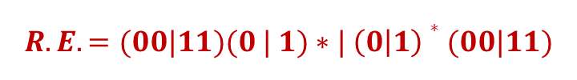


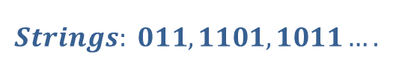


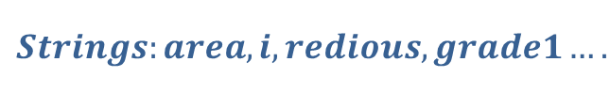
Regular expression examples
All string begins or ends with 00 or 11
Language of all string containing both 11 and 00 as substring
String ending with 1 and not contain 00
Language of C identifier
$$Strings: 00101, 10100,110,01011…$$
$$R.E. =(00|11)(0 | 1)∗| \left(0 | 1\right)∗(00|11)$$
$$Strings: 0011, 1100,100110,010011…$$
$$R.E. ={((0|1)}^{∗}00{(0|1)}^{∗}11{(0|1)}^{∗}) |{ ((0|1)}^{∗}11{(0|1)}^{∗}00{(0|1)}^{∗})$$
$$Strings: 011, 1101,1011….$$
$$R.E. =\left(1 | 01\right)+$$
$$Strings:area, i, redious, grade1….$$
$$R.E. ={(_+L)(_ + L +D)}^{∗}$$
$$where L is Letter \& D is digit$$

Slide 23
Finite Automata

Slide 24
Finite Automata
Finite Automata(FA) is the simplest machine to recognize patterns.
The finite automata or finite state machine is an abstract machine that has five elements or tuples.
It has a set of states and rules for moving from one state to another but it depends upon the applied input symbol. Basically, it is an abstract model of a digital computer.
Types of Finite Automata:
Language Recognizer (Compiler)
DFA
NFA
Output Generator (Digital circuit)
Mealy Machine
Moore Machine

Slide 25
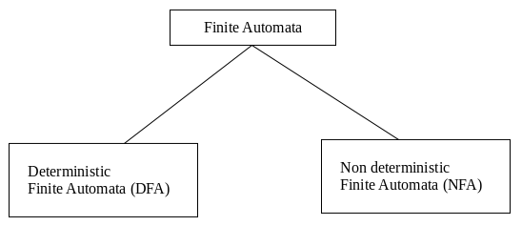
Types of Finite Automata:
DFA: Deterministic refers to the uniqueness of the computation. In a DFA, for a particular input character, the machine goes to one state only. A transition function is defined on every state for every input symbol. DFA does not accept the null move.
NFA: NFA stands for non-deterministic finite automata. It is used to transmit any number of states for a particular input. It can accept the null move. i.e. it can move forward without reading any input.

Slide 26
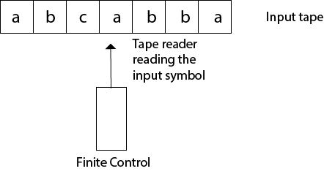
Finite Automata Model:
Finite automata can be represented by input tape and finite control.
Input tape: It is a linear tape having some number of cells. Each input symbol is placed in each cell.
Finite control: The finite control decides the next state on receiving particular input from input tape. The tape reader reads the cells one by one from left to right, and at a time only one input symbol is read.

Slide 27
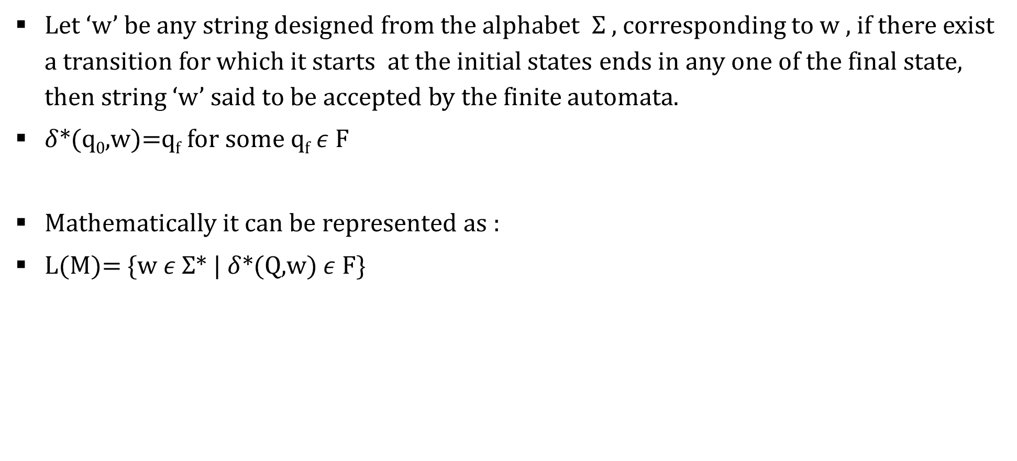
Acceptance by DFA
Let ‘w’ be any string designed from the alphabet $Σ$ , corresponding to w , if there exist a transition for which it starts at the initial states ends in any one of the final state, then string ‘w’ said to be accepted by the finite automata.
$δ$*(q₀,w)=q_{f} for some q_{f} $ε$ F
Mathematically it can be represented as :
L(M)= {w $ε$ $Σ$* | $δ$*(Q,w) $ε$ F}

Slide 28
Applications of DFA
Lexical analysis phase of a compiler.
Design of digital circuit.
String matching.
Communication Protocol for information exchange.

Slide 29
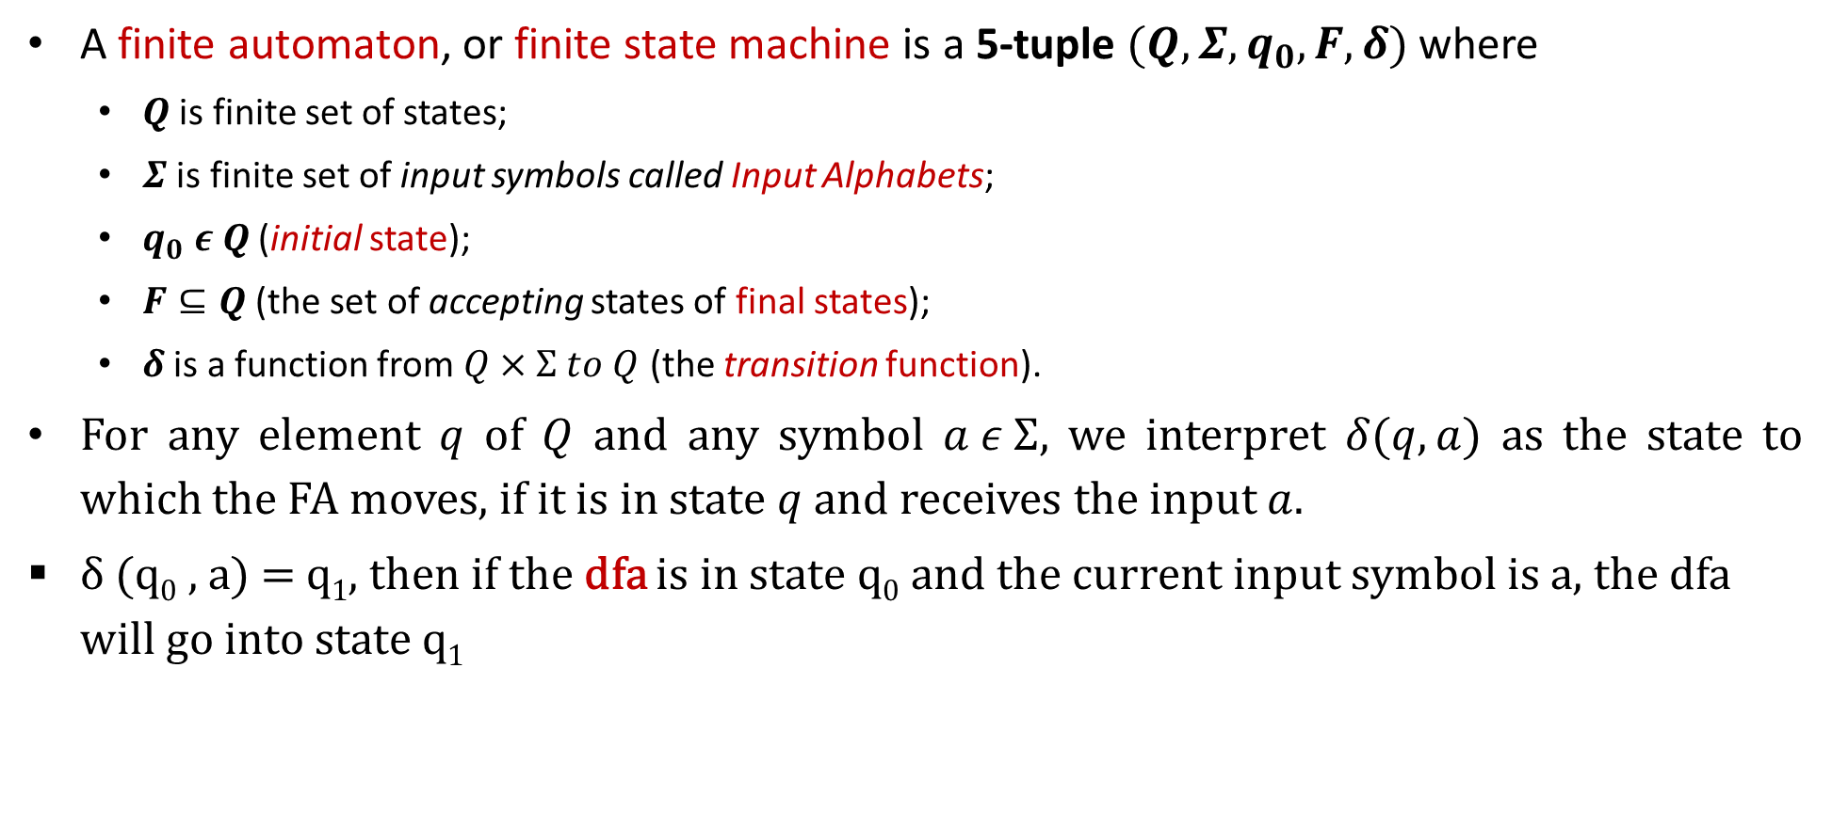
Deterministic Finite Automata
A finite automaton, or finite state machine is a 5-tuple $(Q,Σ,q_{0},F,δ)$ where
$Q$ is finite set of states;
$Σ$ is finite set of input symbols called Input Alphabets;
$q_{0} ε Q$ (initial state);
$F⊆Q$ (the set of accepting states of final states);
$δ$ is a function from $Q×Σ to Q$ (the transition function).
For any element $q$ of $Q$ and any symbol $a ε Σ$, we interpret $δ(q,a)$ as the state to which the FA moves, if it is in state $q$ and receives the input $a$.
δ (q₀ , a) = q₁, then if the dfa is in state q₀ and the current input symbol is a, the dfa will go into state q₁

Slide 30

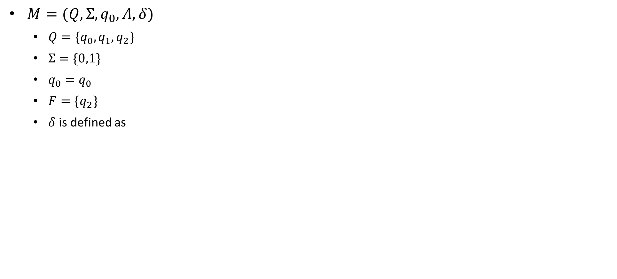
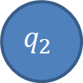
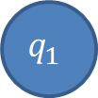
Example: Finite Automata
$M=(Q,Σ,q_{0},A,δ)$
$Q=\{q_{0},q_{1},q_{2}\}$
$Σ=\{0,1\}$
$q_{0}=q_{0}$
$F=\{q_{2}\}$
$δ$ is defined as
Transition Table
δ | Input
State | $$0$$ | $$1$$
$$q_{0}$$ | $$q_{1}$$ | $$q_{0}$$
$$q_{1}$$ | $$q_{2}$$ | $$q_{0}$$
$$q_{2}$$ | $$q_{2}$$ | $$q_{0}$$
1
1
0
$$q_{0}$$
0
$$q_{1}$$
0
$$q_{2}$$
1
Why we are changing state, because FA does not have their own memory. So to remember the input we need to change the state.
Transition State Diagram

Slide 31
Minimum states
Calculate the length of substring.
All strings ending with ‘n’ length substring will always require minimum (n+1) states in the DFA.
All strings starting with ‘n’ length substring will always require minimum (n+2) states in the DFA.

Slide 32
Problem types
Staring with w
Ending with w
w as sub string
w with |w|=2 or 3 or n

Slide 33
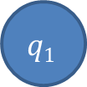
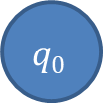
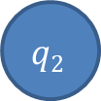
DFA Example: ending with w
The strings ending with 10.
0
1
0
$$q0$$
1
$$q1$$
$$q2$$
1
0

Slide 34
DFA Example: ending with w
The string ending in 10 or 11
1
C
0
1
A
1
B
0
0
1
D
0

Slide 35
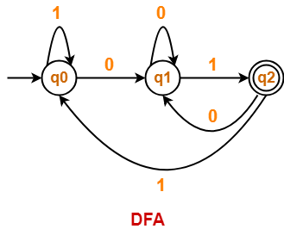
DFA Example: ending with w
Draw a DFA for the language accepting strings ending with ’01’ over input alphabets ∑ = {0, 1}
Regular expression for the given language = (0 + 1)*01
Minimum length=2
Minimum number of states required in the DFA = 2 + 1 = 3.

Slide 36
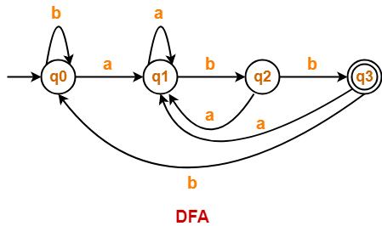
DFA Example: ending with w
Draw a DFA for the language accepting strings ending with ‘abb’ over input alphabets ∑ = {a, b}
Regular expression for the given language = (a + b)*abb
Minimum number of states required in the DFA = 3 + 1 = 4.

Slide 37
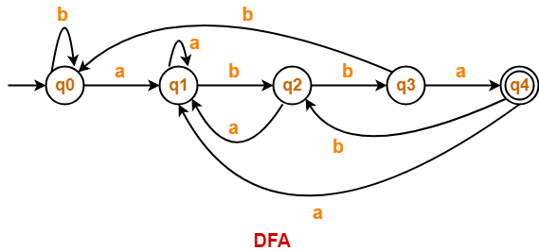
DFA Example: ending with w
Draw a DFA for the language accepting strings ending with ‘abba’ over input alphabets ∑ = {a, b}
Regular expression for the given language = (a + b)*abba
Minimum number of states required in the DFA = 4 + 1 = 5.

Slide 38
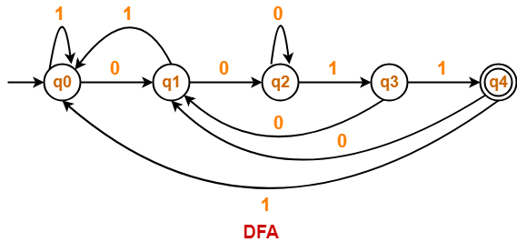
DFA Example: ending with w
Draw a DFA for the language accepting strings ending with ‘0011’ over input alphabets ∑ = {0, 1}
Regular expression for the given language = (0 + 1)*0011
Minimum number of states required in the DFA = 4 + 1 = 5

Slide 39
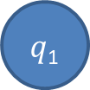
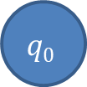

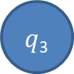

DFA Examples: ends with w
Draw a DFA that accepts a language L over input alphabets ∑ = {a, b} such that L is the set of all strings have last two symbols are same.
Regular expression for the given language = (a + b)*bb + (a + b)*aa
L={aa, bb, aaa, abb, baa, bbb, ….}
a
$q$₁
a
$q$₃
a
b
$$q0$$
b
a
a
b
$q$₂
$$q4$$
b
b
Draw a DFA that accepts a language L over input alphabets ∑ = {a, b} such that L is the set of all strings have last two symbols are different?.

Slide 40
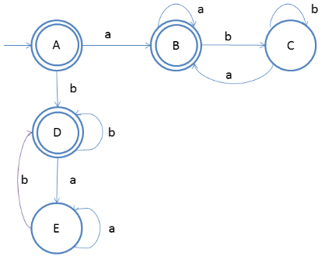
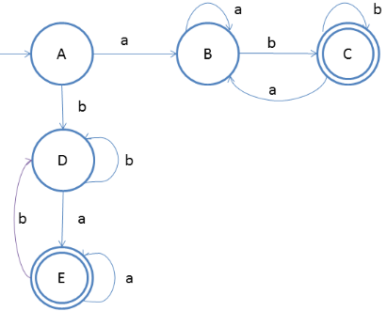
DFA Examples: ends with w
Draw a DFA that accepts a language L over input alphabets ∑ = {a, b} such that L is the set of all strings that
Starts and ends with same symbol.
L={ε, a, b, aa, bb, aba, bab, ababa, aabba, aaabbba,...}
Starts and ends with different symbol.
L = {ab, ab, abab, aabb, aaabbb,...}

Slide 41

DFA Examples: starting with w
Draw a DFA for the language accepting strings starting with ‘ab’ over input alphabets ∑ = {a, b}
Regular expression for the given language = ab(a + b)*
Minimum number of states required in the DFA = 2 + 2 = 4.

Slide 42

DFA Examples: starting with w
Draw a DFA for the language accepting strings starting with ‘a’ over input alphabets ∑ = {a, b}
Regular expression for the given language = a(a + b)*
Minimum number of states required in the DFA = 1 + 2 = 3.
We will construct DFA for the following strings-
a
aa

Slide 43

DFA Examples: starting with w
Draw a DFA for the language accepting strings starting with ‘101’ over input alphabets ∑ = {0, 1}
Regular expression for the given language = 101(0 + 1)*
Minimum number of states required in the DFA = 3 + 2 = 5
We will construct DFA for the following strings-
101
1011
10110
101101

Slide 44

DFA Examples: starting with w
Draw a DFA that accepts a language L over input alphabets ∑ = {0, 1} such that L is the set of all strings starting with ’00’.
Regular expression for the given language = 00(0 + 1)*
Minimum number of states required in the DFA = 2 + 2 = 4
We will construct DFA for the following strings-
00
000
00000

Slide 45

DFA Examples: starting with w
Construct a DFA that accepts a language L over input alphabets ∑ = {a, b} such that L is the set of all strings starting with ‘aa’ or ‘bb’.{initial two letter are same}
Regular expression for the given language = (aa + bb)(a + b)*
Minimum number of states required in the DFA = 5.
We will construct DFA for the following strings-
aa
aaa
aaaa
bb
bbb
bbbb

Slide 46

DFA Examples: starting with w
Construct a DFA that accepts a language L over input alphabets ∑ = {a, b} such that L is the set of all strings starting with ‘aba’.
Regular expression for the given language = aba(a + b)*
Minimum number of states required in the DFA = 3 + 2 = 5.
We will construct DFA for the following strings-
aba
abaa
abaab
abaaba

Slide 47


DFA Examples: in between
The string with next to last symbol as 0.
0
1
$$q2$$
0
$$q0$$
0
$$q1$$
1
1
$$q3$$
0
1

Slide 48
DFA Examples: starts and ends with
The string corresponding to Regular expression {00}*{11}*
0,1
B
1
D
0
0
0
0
1
A
1
C
E
1

Slide 49
DFA Examples: starts and ends with
(a+b)*baaa
b
a
B
a
b
A
b
C
b
b
a
a
E
a
D

Slide 50




DFA Examples: starts and ends with
Draw a DFA that accepts a language L over input alphabets ∑ = {a, b} such that L is the set of all strings that starts with a and ends with b.
Regular expression for the given language = a(a + b)*b
L={ab, aab, abb, aabb, abab, ….}
a
b
$$q0$$
a
$q$₁
b
$q$₂
a
b
$q$₃
a, b

Slide 51


DFA Examples: starts and ends with
All strings over {0, 1} that begin or end with 111
All strings over {0, 1} that begin and end with 111

Slide 52



DFA Examples: of length w
Construct a DFA which accepts set of all strings over Σ={a,b} of length 2 , L = {aa, ab, ba, bb}
Construct a DFA which accepts set of all strings over Σ={a,b} of length ≥2
Construct a DFA which accepts set of all strings over Σ={a,b} of length ≤2

Slide 53






DFA Examples: of length w
Construct a DFA which accepts set of all strings over Σ={a, b} such that every string accepts must |w|=2 mod 3.
|w|=3 mod 4..?
|w|=2 mod 3
|w|_{b}=2 mod 3 (number of b should give 2 as remainder by 3)
a
a
a, b
$$q0$$
b
$$q1$$
$$q0$$
$$q1$$
a, b
b
b
a, b
$$q2$$
$$q2$$
a

Slide 54





DFA Examples: of length w
Construct a DFA which accepts set of all strings over Σ={a, b} such that every string starting with ab and must |w|=2 mod 3.(merge two DFA)
$$q6$$
a, b
a, b
$$q0$$
a
$$q1$$
b
$$q3$$
a, b
$$q4$$
a, b
$$q5$$
a
a
$$q2$$
a, b

Slide 55
DFA Examples: even or odd occurrence
The string with number of 0’s and number of 1’s are even
The string with number of 0’s and number of 1’s are odd ?
1
odd 0 odd 1
odd 0 even 1
1
0
0
0
0
1
odd 1 even 0
even 1 even 0
1

Slide 56
Design…
First design two separate machines for the two conditions:
Accepting only even number of 0’s
Accepting only even number of 1’s
Merge these two and then find the required final states.
To merge these two machines, we will take the Cartesian product of the states of these two machines:
Initial state of these DFA will be the state which contains the initial states of those two separate machines.

Slide 57








The string with number of 0’s and number of 1’s are even L={^, 00, 11, 0011, 1100, 0101, 1010, 1001, 0110….}
Accepting only even no of 1 Accepting only even no of 0
we will take the Cartesian product of the states of these two machines
{q₀,q₁} and {q₂,q₃} => {(q₀q₂),(q₀q₃),(q₁q₂),(q₁q₃)}
0
0
1
1
1
0
$$q0$$
1
$$q1$$
$q$₂
0
$q$₃
Initial state: group of state from both machine
Final state: group that contain at both final state from the machine
i.e. q₀ and q₂ together
$$q02$$
$q0$₃
0
0
1
1
1
1
0
$$q12$$
$q$₁₃
0

Slide 58
The string with number of 0’s or number of 1’s are even L={^, 00, 11, 0011, 1100, 0101, 1010, 1001, 0110….}
Accepting only even no of 1 Accepting only even no of 0
we will take the Cartesian product of the states of these two machines
{q₀,q₁} and {q₂,q₃} => {(q₀q₂),(q₀q₃),(q₁q₂),(q₁q₃)}
0
0
1
1
1
0
$$q0$$
1
$$q1$$
$q$₂
0
$q$₃
Initial state: Where initial state of both machine comes together.
Final state: final state of contain either q₀ or q₂
{all the state which have either q_{o} or q₂}
$$q02$$
$q0$₃
0
0
1
1
1
1
0
$$q12$$
$q$₁₃
0

Slide 59
DFA Examples: even or odd occurrence
Design the following machine
The string with number of 0’s and number of 1’s are even
The string with number of 0’s or number of 1’s are even
The string with odd number of 0’s or even number of 1’s
The string with odd number of 0’s and even number of 1’s

Slide 60



DFA Examples: divisible by
Draw a DFA that accepts a language L over input alphabets ∑ = {0, 1} such that L is the set of all binary number divisible by 3.
Create state for remainders i.e. {0, 1, 2} and then generate any number and try to end up to its remainder state.
0
1
$$q0$$
1
$q$₁
0
$q$₂
1
0
Draw a DFA that accepts a language L over input alphabets ∑ = {0, 1} such that L is the set of all binary number divisible by 4?

Slide 61
DFA Examples: divisible by
DFA divisible by 3
DFA divisible by 4
DFA divisible by 5
Short trick:
Identify the total number of state, if number is divisible by n, total state=n
Create transition table, name the input alphabet in the column
Start filling the state in circular order from left to right to top to bottom.

Slide 62
DFA Examples: divisible by
Divisible by 4
Number of state 4={q0, q1, q2, q3}
Start with q0 and start filling in column 0 and 1 in circular order.
The same logic will work for any number i.e. binary, octal, hexadecimal..
State | 0 | 1
q0 | q0 | q1
q1 | q2 | q3
q2 | q0 | q1
q3 | q2 | q3

Slide 63
DFA divisible by (n₁ and n₂) (n₁ or n₂) (n₁ not n₂) (nor n₁ or nor n₂)
Number of state= LCM(n₁ , n₂)
Initial state remain same
Final state will be based on the operation
Ex.
2 and 3 : no of state = 6, final state: {0,2,4} ∩{0, 3} = {0}
2 or 3 : no of state = 6, final state: {0,2,4} U {0, 3} = {0,2,3,4}
2 not 3: no of state = 6, final state: {0,2,4} – {0,3} = {2,4}
3 not 2: no of state= 6, final state: {0,3}-{0,2,4}
nor 2 nor 3: no of state=6, final state:{U}-{2 or 3}=>{0,1,2,3,4,5}-{0,2,3,4} = {1,5}

Slide 64
DFA Examples: divisible by
Construct the DFA that accepts all octal number which are divisible by 6 but not by 8
Number of state LCM(6,8)=24
Find the number of state of DFA that accepts all hexadecimal number 3 or 5 but not by 7
Number of state LCM(3,5,7)=105
The DFA that accepts all number of base m are divisible by n, requires n no. of state.
( )_{m}= divisible by n =n state required

Slide 65



DFA Examples: Substring
Construct DFA that accepts 01 as substring over the alphabet {0,1}
Construct DFA that accepts 001 as substring over the alphabet {0,1}
Construct DFA that accepts 0101 as substring over the alphabet {0,1}

Slide 66
DFA Examples: sub string
Construct DFA that accepts 111 as substring over the alphabet {0,1}
Construct DFA that accepts 000 or 111 as substring over the alphabet {0,1}
n length substring requires n+1 state in DFA
There will be no dead state in DFA consisting of substring
Finite language does not have state consist of self loop

Slide 67







DFA Example:
0, 1
$$q0$$
0,1
$q$₁
0,1
$q$₂
0,1
DFA length of the string is atleast 3.
DFA where 3rd input symbol from the left is a
DFA where 2nd input symbol from the right is a
L={ab, aa, aab, bab. baaa..}
$q$₃
b
b
a
$$q0$$
a
$q$₁
b
$q$₂
a
b
$q$₃
a

Slide 68
DFA Example
Minimal DFA for the language
L={a^{n}b^{n} | n >=1}
L={a^{m}b^{n} | m, n >1}
L={ab, aab, abb, aabb,…..}
L={a^{m}b^{n} | m, n >=0}
L={^, ab, aba, aab…}
L={a^{2n} | n >=1}
L={aa, aaaa, aaaaaa,…}
L={a^{3n} | n >=1}

Slide 69



Complement of DFA
$Suppose a DFA that is defined by M=(Q,Σ,q_{0},F,δ)$ and it accepts the language L₁. Then DFA that accepts the language L₂ where L₂ = L’₁ => Σ*- L₁ will be defined as
$M′=(Q,Σ,q_{0},Q−F,δ)$
The complement of a DFA can be obtained by making the non-final states as final states and vice-versa. The language accepted by the complemented DFA L₂ is the complement of the language L₁. (Warning! This is not true for NFA’s)
Example 1:
L1: set of all strings over {a, b} of even length
L1 = {$∈$, ab, aa, abaa, aaba, ....}
L2: set of all strings over {a, b} of odd length
L2 = { a, b, aab, aaa, bba, bbb, ...}

Slide 70



Example-2: L₁: set of all strings over {a, b} starting with ‘a’.
L1 ={ a, ab, aa, aba, aaa, aab, ..}
L2: set of all strings over {a, b} not starting with ‘a’.
L2 ={$∈$, b, ba, bb, bab, baa, bba, ...}

Slide 71


Create a DFA that does not accept contain substring aa.
Create a DFA that accepts all the string over a and b where number of b is divisible by 3.

Slide 72
Decision properties of FA
Decidable problem: A problem p is said to be decidable if there exist some generalized algorithm to solve problem.
Undecidable problem: A problem p is said to be undecidable if there is no generalized algorithm to solve problem.
Decision properties:
Emptiness problem
Finiteness problem
Equivalence problem
Membership problem

Slide 73

Emptiness Problem
The emptiness problem in Finite Automata is to decide whether the given automata are accepting empty language or not.
There is an Algorithm available to check the emptiness of Finite Automata.
Step 1: Select those states which are not reachable from the initial state, delete those states and transitions. Using DFS or BFS.
Step 2: In the remaining Finite Automata, if at least one final state then it is accepting non-empty language otherwise empty language.
Conclusion: The emptiness problem of finite automata is decidable and decision problem.

Slide 74


Finiteness Problem
The finiteness problem in Finite Automata is to decide whether the given automata is accepting finite language or infinite language.
There is an Algorithm available to check the finiteness of Finite Automata.
Step 1: Select those states which are not reachable from the initial state, delete those states and transitions. Using DFS.
Step 2: In the remaining Finite Automata, if any state from which we cannot reach the final state, delete those states and transitions.
Step 3: In the remaining Finite Automata, if at least one cycle is available then it is accepting infinite language otherwise finite language.
Conclusion: The finiteness problem of finite automata is decidable and decision problem.

Slide 75
Equivalence Problem
The equivalence problem in Finite Automata is to decide whether the given two automata are accepting the same language or not.
There is an Algorithm available to check the equivalence of given two Finite Automata.
Step 1: Create a transition table for given FAs.
Step 2: If any entry of the table contains the final state of one automaton and the non-final state of other automata then the given FAs are not accepting the same language.
Conclusion: The equivalence problem of finite automata is decidable and decision problem.

Slide 76


Transition table entries are in form of (A, B), where A is the state from Finite Automata 1 and B is the state from Finite Automata 2. NF means Non-Final State F means Final State
Above transition table does not contain any conflicting entry hence the given FAs are accepting the same language.

Slide 77
Membership problem
“is string w is accepted by DFA?
Solution: Testing membership

Slide 78

Minimization of DFA
The process of elimination of states whose presence or absence does not affects the language accepting capability of DFA. It is always unique for a language.
The process of reducing a given DFA to its minimal form is called as minimization of DFA.
It contains the minimum number of states.
The DFA in its minimal form is called as a Minimal DFA
How To Minimize DFA?
The two popular methods for minimizing a DFA are-

Slide 79
Minimization of DFA Using Equivalence Theorem-
Step-01: Eliminate all the dead states(keep one) and inaccessible states from the given DFA (if any).
Dead State: All those non-final states which transit to itself for all input symbols in ∑ are called as dead states.
Inaccessible State: All those states which can never be reached from the initial state are called as inaccessible states.
Step-02:
Draw a state transition table for the given DFA.
Transition table shows the transition of all states on all input symbols in Σ.
Step-03:
Take a counter variable k and initialize it with value 0.
Divide Q (set of states) into two sets such that one set contains all the non-final states and other set contains all the final states.
This partition is called P₀.

Slide 80
Step-04:
Increment k by 1.
Find P_{k} by partitioning the different sets of P_{k-1} .
In each set of P_{k-1} , consider all the possible pair of states within each set and if the two states are distinguishable, partition the set into different sets in P_{k}.
Two states q₁ and q₂ are distinguishable in partition P_{k} for any input symbol ‘a’,
if δ (q₁, a) and δ (q₂, a) are in different sets in partition P_{k-1}.
Step-05:
Repeat step-04 until no change in partition occurs.
In other words, when you find P_{k} = P_{k-1}, stop.
Step-06:
All those states which belong to the same set are equivalent.
The equivalent states are merged to form a single state in the minimal DFA
Number of states in Minimal DFA = Number of sets in P_{k}

Slide 81



Problem 1
Step 1: The given DFA contains no dead states and inaccessible states.
Step 2: Draw a state transition table-
Step 3: Now using Equivalence Theorem, we have-
P0 = { q0 , q1 , q2 , q3 } { q4 } :set of final and non final
P1 = { q0 , q1 , q2 } { q3 } { q4 } :behavior or transition of q3 on input {a, b} is different from q0,q1,q2
P2 = { q0 , q2 } { q1 } { q3 } { q4 } :behavior or transition of q3 on input {a, b} is different from q0,q1,q2
P3 = { q0 , q2 } { q1 } { q3 } { q4 }
Since P3 = P2, so we stop.
From P3, we infer that states q0 and q2 are equivalent and can be merged together.
So, Our minimal DFA is-

Slide 82




Problem 2
Step-01: State q₃ is inaccessible from the initial state.
So, we eliminate it and its associated edges from the DFA.
Step-02: Draw a state transition table-
Step-03:
Now using Equivalence Theorem, we have-
P₀ = { q₀ } { q₁ , q₂ }
P₁ = { q₀ } { q₁ , q₂ }
Since P₁ = P₀, so we stop.
From P₁, we infer that states q₁ and q₂ are equivalent and can be merged together.
So, Our minimal DFA is-

Slide 83




Problem 3, 4

Slide 84




Problem 5
0
0
0,1
$$a$$
1
$$c$$
1
$$f$$

Slide 85
Minimization of DFA using Myhill-Nerode(Table filling)
Steps for the Minimization of DFA :
Create the pairs of all the states involved in the given DFA.
Mark all the pairs (Qa,Qb) such a that Qa is Final state and Qb is Non-Final State.
If there is any unmarked pair (Qa,Qb) such a that δ(Qa,x) and δ(Qb,x) is marked, then mark (Qa,Qb). Here x is a input symbol. Repeat this step until no more marking can be made.
Combine all the unmarked pairs and make them a single state in the minimized DFA

Slide 86





Example 1
Step-1: Create the pairs of all the states involved in DFA.
Step-2: Mark all the pairs (Qa,Qb) such a that Qa is Final state and Qb is Non-Final State.
Step-3: If there is any unmarked pair (Qa,Qb) such a that δ(Qa,x) and δ(Qb,x) is marked, then mark (Qa,Qb). Here x is a input symbol. Repeat this step until no more marking can be made.

Slide 87






Slide 88






Slide 89


Slide 90





Nondeterministic Finite Automata (NFA)
A nondeterministic finite automaton is a 5-tuple $M=(Q,Σ,q_{0},F,δ)$
$Q$ is finite set of states;
$Σ$ is finite set of input symbols called Input Alphabets;
$q_{0} ε Q$ (initial state);
$F⊆Q$ (the set of accepting states of final states);
$δ$ is a function from $Q×Σ →2Q$ (the transition function).
If $Σ$={a,b}$then 2^{Q}$ : {ɸ, {a}, {b}, {a,b} }
$$q0$$
$$q0$$
a
$$q0$$
$$q0$$
a
a
$$q0$$

Slide 91
Why we need non deterministic
All machines around us are deterministic
Theoretical model is possible, but actual implementation is not possible
We do not have software or hardware that work as non deterministically
Why it is important…???
NFA
DFA
Minimal DFA
Design complexity

Slide 92
Regular
Grammar
Regular
Language
If any regular language in the world DFA is possible then NFA is also possible and vice-versa
Every DFA is also a NFA
We can convert every NFA to DFA
For all
Finite Automata
For all
DFA
NFA
= power

Slide 93






Acceptance by NFA
A string w is said to be accepted by NFA if there exist at least one transition path on which we start at initial state and ends at final state.
$δ$*(q₀,w) = F
a, b
a, b
$$q0$$
a
$q$1
$$q0$$
a
$q$1
b
a
$q$2
a, b
$q$2
a, b

Slide 94




Example

Slide 95






Example of NFA for ${\{11+110\}}^{∗}\{0\}$
$$M=(Q,Σ,q_{0},A,δ)$$
$Q=\{q_{0},q_{1},q_{2},q_{3},q_{4}\}$
$Σ=\{0,1\}$
$q_{0}=q_{0}$
$A=\{q_{4}\}$
$δ$ is defined as
δ | Input
State | $$0$$ | $$1$$
$$q_{0}$$ | $$\{q_{4}\}$$ | $${\{q}_{1},q_{2}\}$$
$$q_{1}$$ | $$∅$$ | $$\{q_{0}\}$$
$$q_{2}$$ | $$∅$$ | $$\{q_{3}\}$$
$$q_{3}$$ | $${\{q}_{0}\}$$ | $$∅$$
$$q_{1}$$
$$q_{4}$$ | $$∅$$ | $$∅$$
1
1
$$q_{0}$$
0
$$q_{4}$$
1
0
$$q_{2}$$
$$q_{3}$$
1

Slide 96


NFA: ending with w
NFA that accepts all binary strings that end with 101.
Accepts all binary strings where the last symbol is 0 or that contain only 1’s.

Slide 97


Examples
Design a NFA of all binary strings in which 2nd last bit is 1.
L= {10, 010, 000010, 11, 101011……..}
Design an NFA with ∑ = {0, 1} accepts all string ending with 01.
L= {01, 0101, 0000101, 101, 101001……..}

Slide 98


Examples
Construct an NFA with ∑ = {0, 1} in which a substring “double ‘1’ is followed by single ‘0’” must exist.
L= {110, 0110, 1110 , 10100110……..}
Construct an NFA in which all the string contains a substring 1101.
L= {1101, 110101, 1101000101, 01101, 1011011……..}

Slide 99
DFA Vs. NFA
SR.NO. | DFA | NFA
1 | DFA stands for Deterministic Finite Automata. | NFA stands for Nondeterministic Finite Automata.
2 | For each sigma value (0, 1…n) there must be a provided path from each state. | For each sigma value (0, 1…n) there is no need to specify path from each state
3 | As DFA provide a path for each input, that’s why all digital computers are deterministic. | As NFA does not provide a path for each input, that’s why NFA not use in digital computers.
4 | Multiple choices are not available corresponding to an output. | Multiple choices are available corresponding to an output.
5 | DFA cannot use Empty String (Epsilon) transition. | NFA can use Empty String (Epsilon) transition.

Slide 100
DFA Vs. NFA
6 | DFA is more difficult to construct and understand. | NFA is easier to construct and understand.
7 | All DFA are NFA. | Not all NFA are DFA.
8 | DFA requires more space. Because it has normally more states. | NFA requires less space then DFA. Because it has normally less states
Note: While conversion of NFA to DFA, If NFA maximum states are n Then DFA maximum number of states will be 2^{n}.
9 | Dead State cannot used in NFA | Dead State is used in NFA
10 | Trap State is used in DFA | Trap State is not used in DFA

Slide 101


Trap vs Unreachable state

Slide 102
NFA to DFA conversion
Steps For Converting NFA to DFA
There are five basic steps for conversion of NFA to DFA.
Step 01: Draw NFA.
Step 02: Draw NFA transition Table.
Step 03: Now convert NFA transition Table To its corresponding DFA transition Table.
Step 04: Through DFA transition Table draw DFA.
Step 05: If “q_{k}” was the final state in NFA, then all those states will be the final in DFA where “q_{k}” exist.

Slide 103

Problem 1
Convert the following Non-Deterministic Finite Automata (NFA) to Deterministic Finite Automata (DFA)-
Transition table for the given Non-Deterministic Finite Automata (NFA) is-
Step-01:
Let Q’ be a new set of states of the Deterministic Finite Automata (DFA).
Let T’ be a new transition table of the DFA.
Step-02:
Add transitions of start state q0 to the transition table T’.
State | a | b
→q0 | q0 | q0, q1
q1 | – | *q2
*q2 | – | –
State | a | b
→q0 | q0 | {q0, q1}

Slide 104

Step-03:
New state present in state Q’ is {q0, q1}.
Add transitions for set of states {q0, q1} to the transition table T’.
State | a | b
→q0 | q0 | {q0, q1}
{q0, q1} | q0 | {q0, q1, q2}
Step-04:
New state present in state Q’ is {q0, q1, q2}.
Add transitions for set of states {q0, q1, q2} to the transition table T’.
State | a | b
→q0 | q0 | {q0, q1}
{q0, q1} | q0 | {q0, q1, q2}
{q0, q1, q2} | q0 | {q0, q1, q2}
Step-05:
Since no new states are left to be added in the transition table T’, so we stop.
States containing q2 as its component are treated as final states of the DFA
Finally, Transition table for Deterministic Finite Automata (DFA) is-
State | a | b
→q0 | q0 | {q0, q1}
{q0, q1} | q0 | *{q0, q1, q2}
*{q0, q1, q2} | q0 | *{q0, q1, q2}

Slide 105




Problem-2, 3:

Slide 106





Slide 107
Important Points-
It is important to note the following points when converting a given NFA into a DFA-
Note-01:
After conversion, the number of states in the resulting DFA may or may not be same as NFA.
The maximum number of states that may be present in the DFA are 2^{Number of states in the NFA}.
Note-02:
In general, the following relationship exists between the number of states in the NFA and DFA-
1 <= n <= 2^{m}
Here,
n = Number of states in the DFA
m = Number of states in the NFA
Note-03:
In the resulting DFA, all those states that contain the final state(s) of NFA are treated as final states.

Slide 108

Epsilon NFA
An epsilon nondeterministic finite automaton (NFA) has null or epsilon transitions from one state to another. Epsilon NFA is also called a null NFA or an NFA lambda.
A regular expression for a language forms an epsilon NFA. This epsilon NFA then converts to a simple NFA. We then use the simple NFA to make a deterministic finite automaton (DFA).
Let's suppose an NFA < Q, Σ, q0​​, F, δ > and S⊆Q is a defined set of states, where:
$Q$ is finite set of states;
$Σ$ is finite set of input symbols called Input Alphabets;
$q_{0} ε Q$ (initial state);
$F⊆Q$ (the set of accepting states of final states);
$δ$ is a function from $Q×\{ε U Σ\} →2Q$ (the transition function). |$ε |$= zero length string

Slide 109







Example: Recursive Definition of $δ^{∗}$ in NFA
$$=\bigcup_{r∈δ^{∗}(q_{0},11)}{δ(r,1)}$$
$$δ^{∗}\left(q_{0},111\right)$$
$$=\bigcup_{r∈\{q_{0},q_{1},q_{2}\}}{δ(r,1)}$$
$$=δ\left(q_{0},1\right)∪ δ\left(q_{1},1\right)∪ δ\left(q_{2},1\right)$$
$$=\left\{q_{0},q_{1},q_{2},q_{3}\right\}$$
$$=\bigcup_{r∈δ^{∗}(q_{0},01)}{δ(r,1)}$$
$$δ^{∗}\left(q_{0},011\right)$$
$$=δ\left(q_{0},1\right)∪ δ\left(q_{1},1\right)$$
$$=\left\{q_{0},q_{1},q_{2}\right\}$$

Slide 110
NFA to FA using subset construction method

Slide 111

Example 1: Conversion from NFA to FA
2
a
b
$$q$$ | $$δ\left(q,a\right)$$ | $$δ\left(q,b\right)$$
1 | {2,3} | {4}
2 | {$φ$} | {4}
3 | {4} | {3}
4 | {$φ$} | $\{φ$}
1
b
4
a
a
3
Transition Table
b
NFA

Slide 112







Example 1: Conversion from NFA to FA
$$δ_{1}\left(1,a\right)= \{2,3\}$$
$$δ_{1}\left(1,b\right)= \{4\}$$
$$δ_{1}\left(\left\{2,3\right\},a\right)= δ\left(2,a\right) ∪δ(3,a)$$
$$= \{4\}$$
$$δ_{1}\left(\left\{2,3\right\},b\right)= δ\left(2,b\right) ∪δ(3,b)$$
$$= \{3,4\}$$
$$δ_{1}(4,a)= \{∅\}$$
1
a
2,3
b
3,4
$$δ_{1}(4,b)= \{∅\}$$
a
b
4

Slide 113





Example 1: Conversion from NFA to FA
$$δ_{1}\left(\{3,4\},a\right)=δ\left(3,a\right) ∪δ(4,a)$$
$$= \{4\}$$
$$δ_{1}\left(\left\{3,4\right\},b\right)= δ\left(3,b\right) ∪δ(4,b)$$
$$= \{3\}$$
$$δ_{1}(3,a)= \{4\}$$
$$δ_{1}(3,b)= \{3\}$$
1
a
2,3
b
3,4
a
a
b
b
4
a
3
b

Slide 114




Example 2: Conversion from NFA to FA
δ | Input
State | $$0$$ | $$1$$
$$q_{0}$$ | $${\{q}_{o}\}$$ | $${\{q}_{0},q_{1}\}$$
$$q_{1}$$ | $${\{q}_{2}\}$$ | $${\{q}_{2}\}$$
$$q_{2}$$ | $${\{q}_{3}\}$$ | $${\{q}_{3}\}$$
$$q_{3}$$ | $$∅$$ | $$∅$$
0, 1
$$q_{0}$$
1
$$q_{1}$$
0, 1
$$q_{2}$$
0, 1
$$q_{3}$$

Slide 115









Example 2: Conversion from NFA to FA
$$q_{0}q_{3}$$
0
0
$$q_{0}q_{2}$$
1
0
$$q_{0}$$
1
$$q_{0}q_{1}$$
$$q_{0}q_{1}q_{3}$$
1
$$q_{0}q_{1}q_{2}$$
$$δ_{1}\left(\{q_{0}\},0\right)=\{q_{0}\}$$
$$δ_{1}\left(\{q_{0}\},1\right)=\{q_{0},q_{1}\}$$
$$δ_{1}\left(\{q_{0},q_{1}\},0\right)=δ\left(\left\{q_{0}\right\},0\right)∪δ\left(\left\{q_{1}\right\},0\right)=\left\{q_{0}\right\}∪\left\{q_{2}\right\}=\{q_{0},q_{2}\}$$
$$δ_{1}\left(\{q_{0},q_{1}\},1\right)=δ\left(\left\{q_{0}\right\},1\right)∪δ\left(\left\{q_{1}\right\},1\right)=\left\{q_{0},q_{1}\right\}∪\left\{q_{2}\right\}=\{q_{0},q_{1},q_{2}\}$$
$$δ_{1}\left(\{q_{0},q_{2}\},0\right)=δ\left(\left\{q_{0}\right\},0\right)∪δ\left(\left\{q_{2}\right\},0\right)=\left\{q_{0}\right\}∪\left\{q_{3}\right\}=\{q_{0},q_{3}\}$$
$$δ_{1}\left(\{q_{0},q_{2}\},1\right)=δ\left(\left\{q_{0}\right\},1\right)∪δ\left(\left\{q_{2}\right\},1\right)=\left\{q_{0},q_{1}\right\}∪\left\{q_{3}\right\}=\{q_{0},q_{1},q_{3}\}$$

Slide 116








Example 2: Conversion from NFA to FA
$$δ_{1}\left(\{q_{0},q_{1},q_{2}\},0\right)=δ\left(\left\{q_{0}\right\},0\right)∪δ\left(\left\{q_{1}\right\},0\right)∪δ\left(\left\{q_{2}\right\},0\right)= \{q_{0},q_{2},q_{3}\}$$
$$δ_{1}\left(\{q_{0},q_{1},q_{2}\},1\right)=δ\left(\left\{q_{0}\right\},1\right)∪δ\left(\left\{q_{1}\right\},1\right)∪δ\left(\left\{q_{2}\right\},1\right)= \{q_{0},q_{1},q_{2},q_{3}\}$$
$$δ_{1}\left(\{q_{0},q_{3}\},0\right)=δ\left(\left\{q_{0}\right\},0\right)∪δ\left(\left\{q_{3}\right\},0\right)= \{q_{0}\}$$
$$δ_{1}\left(\{q_{0},q_{3}\},1\right)=δ\left(\left\{q_{0}\right\},1\right)∪δ\left(\left\{q_{3}\right\},1\right)= \{q_{0},q_{1}\}$$
0
$$q_{0}q_{3}$$
1
0
0
$$q_{0}q_{2}$$
1
$$q_{0}q_{1}q_{3}$$
0
$$q_{0}$$
1
$$q_{0}q_{1}$$
$$q_{0}q_{2}q_{3}$$
0
1
$$q_{0}q_{1}q_{2}$$
1
$$q_{0}q_{1}q_{2}q_{3}$$

Slide 117







Example 2: Conversion from NFA to FA
$$δ_{1}\left(\{q_{0},q_{1},q_{3}\},0\right)=δ\left(\left\{q_{0}\right\},0\right)∪δ\left(\left\{q_{1}\right\},0\right)∪δ\left(\left\{q_{3}\right\},0\right)= \{q_{0},q_{2}\}$$
$$δ_{1}\left(\{q_{0},q_{1},q_{3}\},1\right)=δ\left(\left\{q_{0}\right\},1\right)∪δ\left(\left\{q_{1}\right\},1\right)∪δ\left(\left\{q_{3}\right\},1\right)= \{q_{0},q_{1},q_{2}\}$$
$$δ_{1}\left(\{q_{0},q_{2},q_{3}\},0\right)=δ\left(\left\{q_{0}\right\},0\right)∪δ\left(\left\{q_{2}\right\},0\right)∪δ\left(\left\{q_{3}\right\},0\right)= \{q_{0},q_{3}\}$$
$$δ_{1}\left(\{q_{0},{q_{2},q}_{3}\},1\right)=δ\left(\left\{q_{0}\right\},1\right)∪δ\left(\left\{q_{2}\right\},1\right)∪δ\left(\left\{q_{3}\right\},1\right)= \{q_{0},q_{1},q_{3}\}$$
0
$$q_{0}q_{3}$$
1
0
$$q_{0}q_{2}$$
0
$$q_{0}q_{2}$$
1
$$q_{0}q_{1}q_{3}$$
0
0
0
$$q_{0}$$
1
$$q_{0}q_{1}$$
$$q_{0}$$
$$q_{0}q_{1}$$
1
1
$$q_{0}q_{2}q_{3}$$
0
1
$$q_{0}q_{1}q_{2}$$
$$q_{0}q_{1}q_{2}$$
1
$$q_{0}q_{1}q_{2}q_{3}$$

Slide 118








Example 2: Conversion from NFA to FA
$$δ_{1}\left(\{q_{0},q_{1},q_{2},q_{3}\},0\right)=δ\left(\left\{q_{0}\right\},0\right)∪δ\left(\left\{q_{1}\right\},0\right)∪δ\left(\left\{q_{2}\right\},0\right)∪δ\left(\left\{q_{3}\right\},0\right)= \{q_{0},q_{2},q_{3}\}$$
$$δ_{1}\left(\{q_{0},q_{1},q_{2},q_{3}\},1\right)=δ\left(\left\{q_{0}\right\},1\right)∪δ\left(\left\{q_{1}\right\},1\right)∪δ\left(\left\{q_{2}\right\},1\right)∪δ\left(\left\{q_{3}\right\},1\right)= \{q_{0},q_{1},q_{2},q_{3}\}$$
As now no new states are obtained, the process stops and we need to define the accepting states.
To define accepting states, the states which contain the accepting states of NFA will be accepting states of final FA.
0
$$q_{0}q_{3}$$
1
0
0
$$q_{0}q_{2}$$
1
$$q_{0}q_{1}q_{3}$$
0
0
0
$$q_{0}$$
1
$$q_{0}q_{1}$$
1
1
$$q_{0}q_{2}q_{3}$$
0
1
$$q_{0}q_{1}q_{2}$$
1
0
1
$$q_{0}q_{1}q_{2}q_{3}$$

